Slide 1
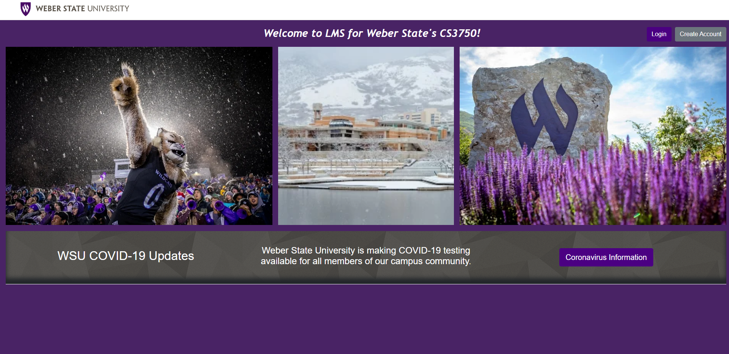
LMS - Architecture
The Git’r Dun Team
Notes:
Hello, my name is Spencer and I’m going to speak about the architecture for the Git’r Dun Team’s Learning Management System.

Slide 2
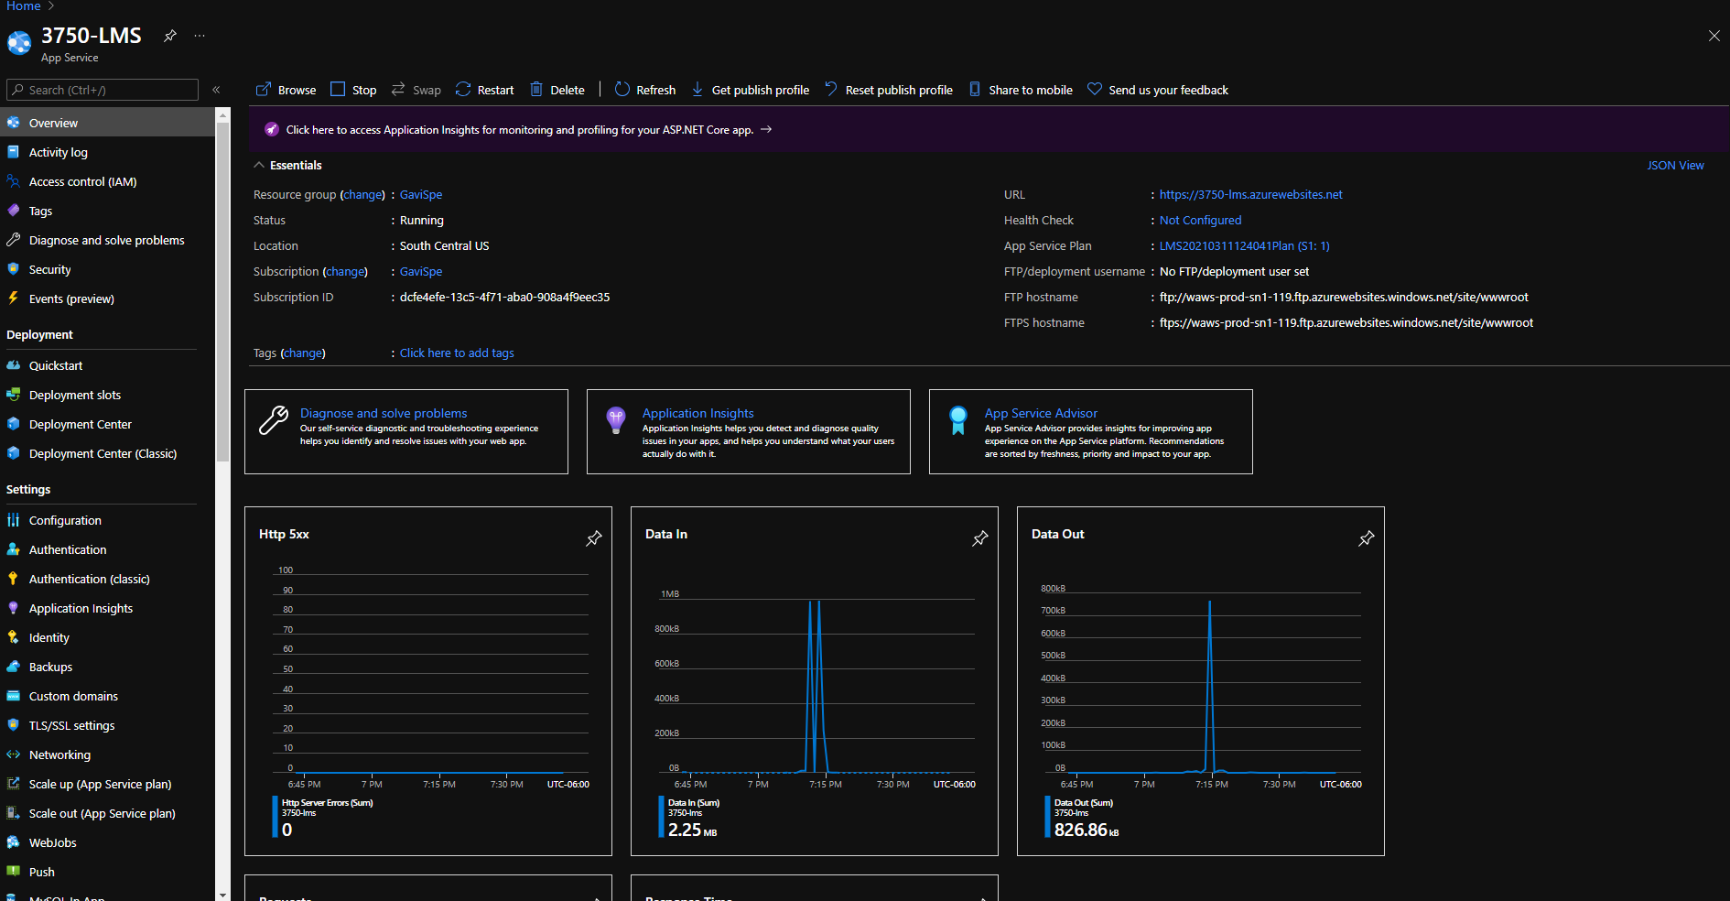
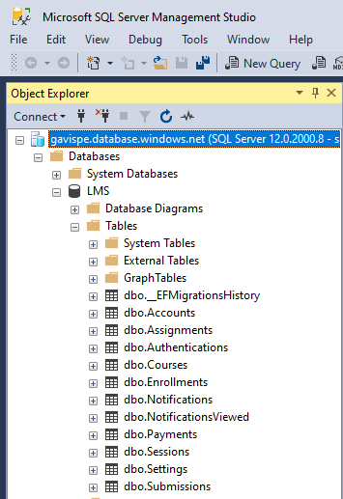
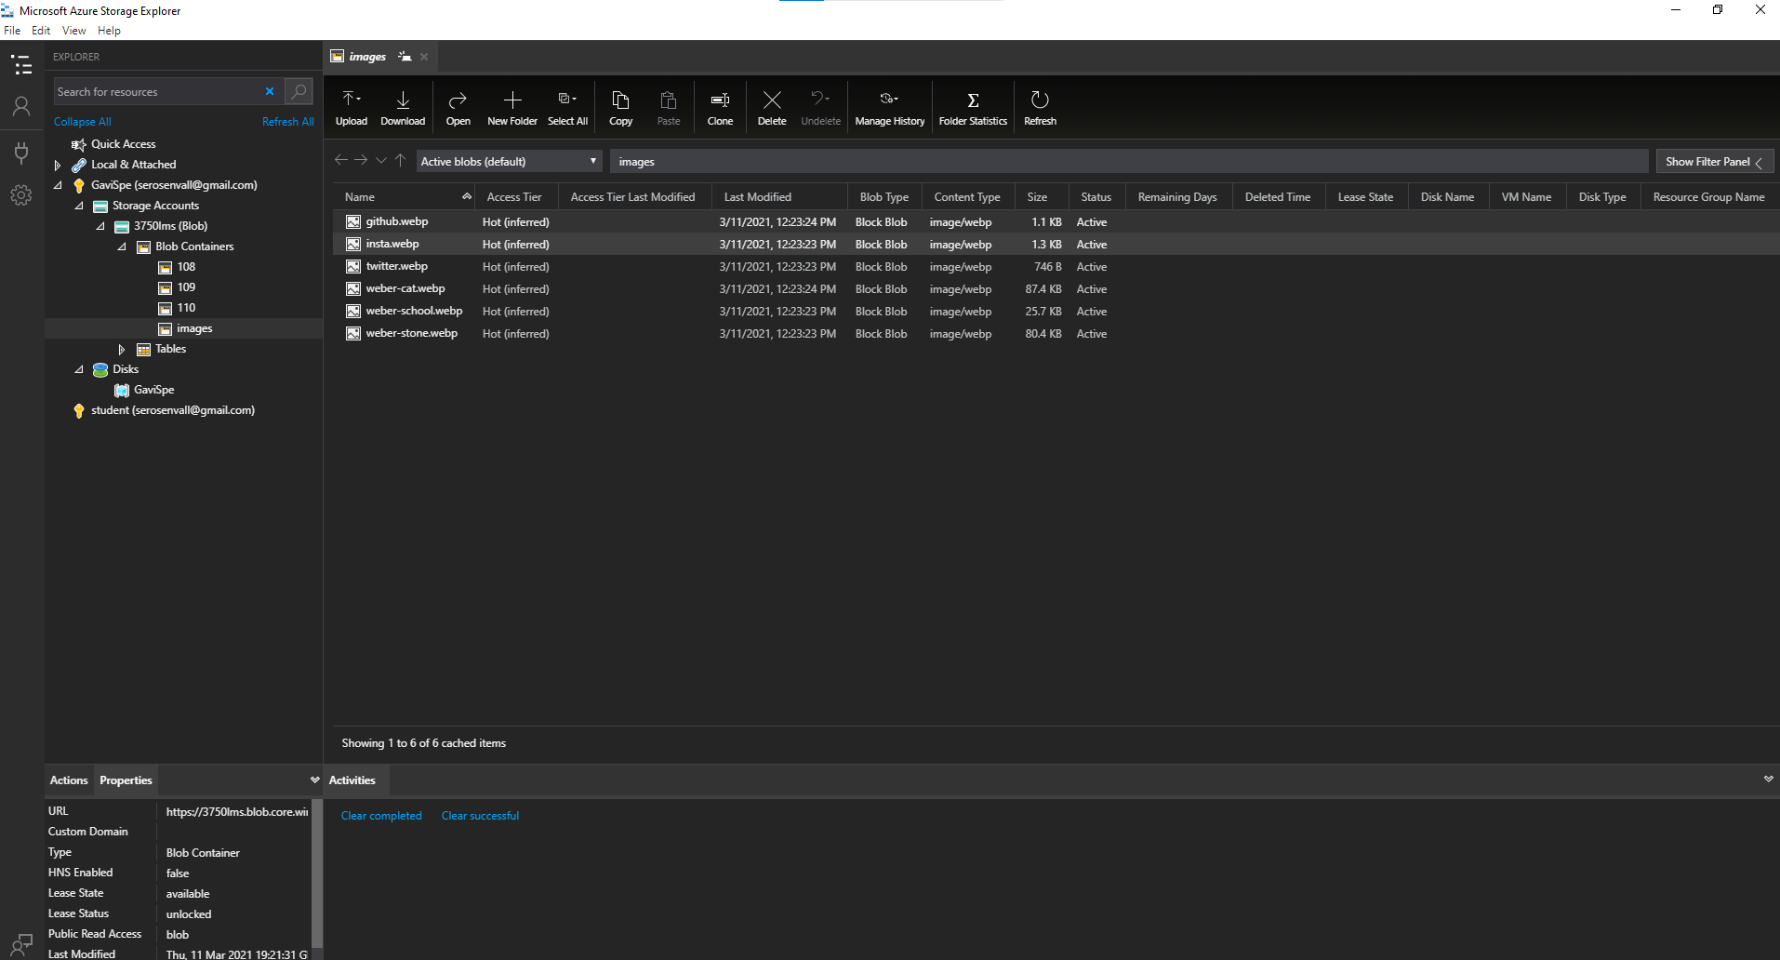
Microsoft Azure DevOps
Free for Students (https://azure.microsoft.com/en-us/free/students/)
Azure SQL Server
Azure SQL Database
SSMS
Azure App Service
Azure BLOB Storage
Visual Studio IDE
Notes:
For a learning management system we decided it would be easiest and the most secure to use web-based architecture for our LMS scenario. Most native to .Net is naturally Microsoft’s Azure. In the Azure suite, a variety of free products are available to students with a valid school email. With one email, one year of access to basic features all used in this project are free. Some of those basic features include: Azure SQL Server, Azure SQL Database, SSMS, Azure App Services, and Azure BLOB Storage. Azure SQL Server and Azure SQL Database are almost identical to the regular SQL Server and Database, there are just a few caveats to the Azure DB architecture and security. Normal SQL operations are all the same which was easy for us to leverage because of previous SLQ course requirements. Naturally, we used SQL Server Management Studio, or SSMS for short, to manage our database. In the right picture you can see the basic schema for our database. Azure App Service allows us to almost effortlessly deploy our code to a site name of our choosing, in this case: 3750-lms.azurewebsites.net directly from the Visual Studio Integrated Development Environment. Finally, we used Azure BLOB Storage to host and store any files that our app needs.

Slide 3
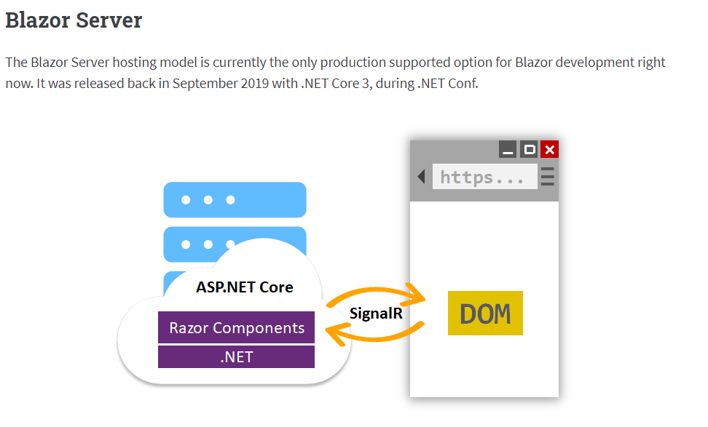
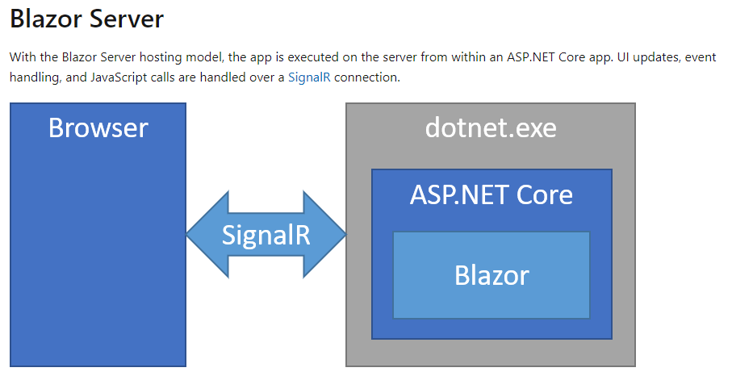
Blazor Server
Transpiled into Webassembly
Blazor can do anything HTML & CSS
can do
Blazor can do anything JS can do
SignalR without JS
LazyLoading
Service Oriented
Notes:
The next thing to add to our tech stack was the framework. We decided to go with Blazor Server. It’s not only the latest and greatest, but it actually is supported for production by Microsoft unlike it’s Blazor Webassembly counterpart. Blazor Server is very powerful in that it is perfect for serving pages quickly and efficiently. It utilizes Razor pages, Controllers, and Routing along with SignalR to quickly transpile c# code into webassembly code, which is native to all browsers. Because Blazor Server utilizes SignalR, the client DOM can be redrawn whenever changes are detected on either Client Side or Server Side. This makes Blazor an excellent option for LMS to receive real-time data for all connected users.

Slide 4
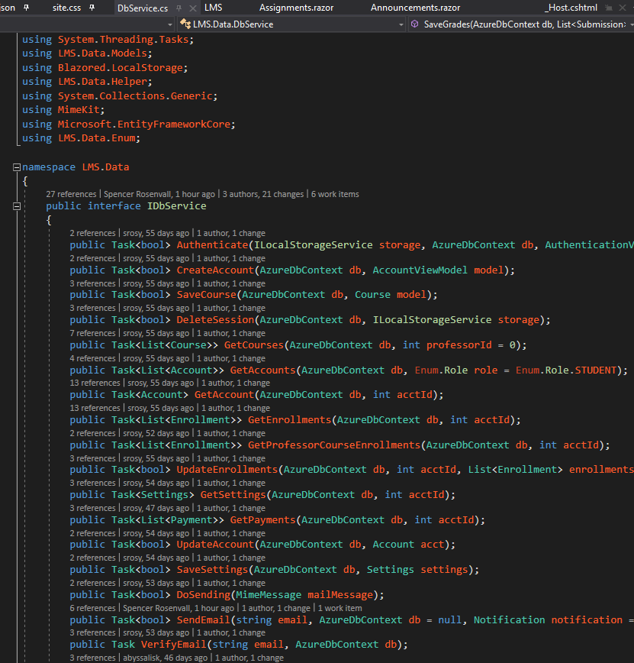
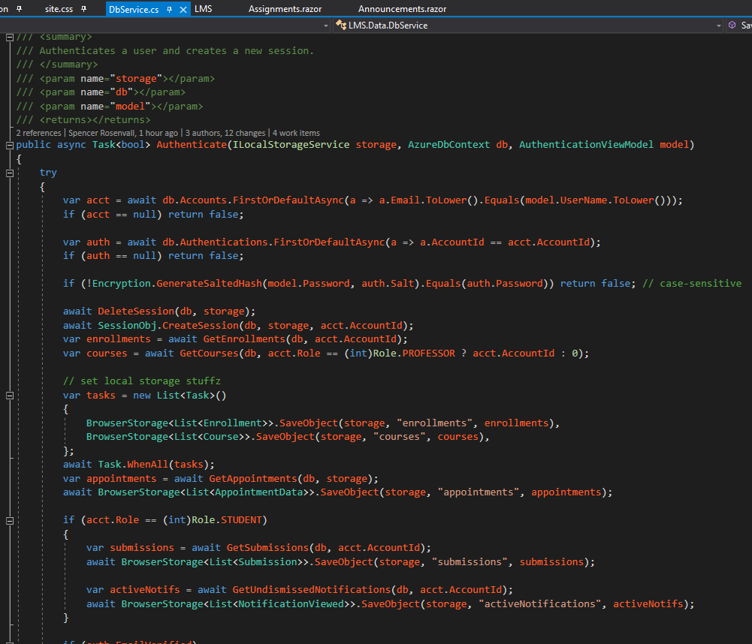
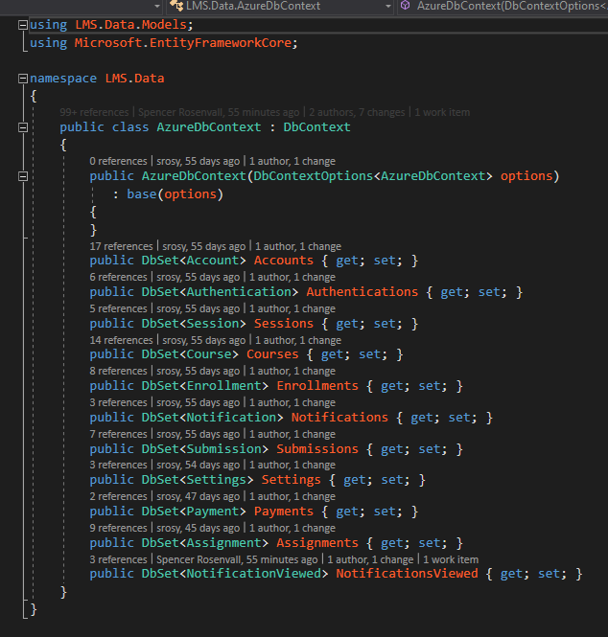
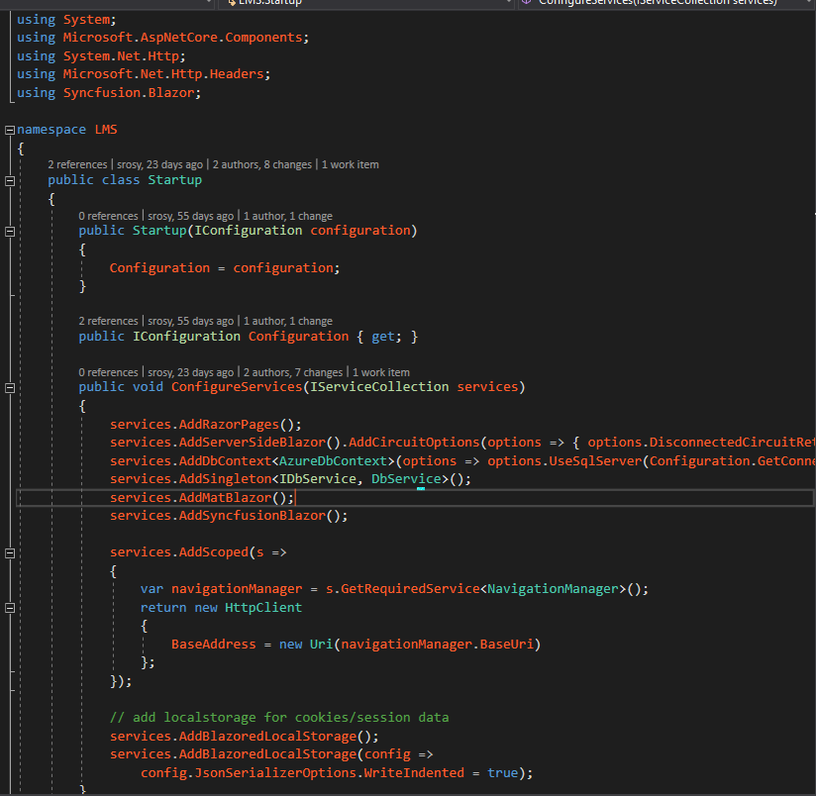
Data Access
Entity Framework
LINQ
DbService
Notes:
To access our data in our databases we utilized the Entity Framework. Though notorious for being slower than competitors like Dapper, in our case of using relational databases and expecting large scale accessibility, Entity Framework was a good choice because of its reliability, support from Microsoft, and code manageability. In the pictures on the slide you can see it’s as simple as created a context for your Database that outlines all your tables then registering that context in the startup.cs file. We extended that usability by making a Database Service called DBService for our pages to access data across the app.

Slide 5
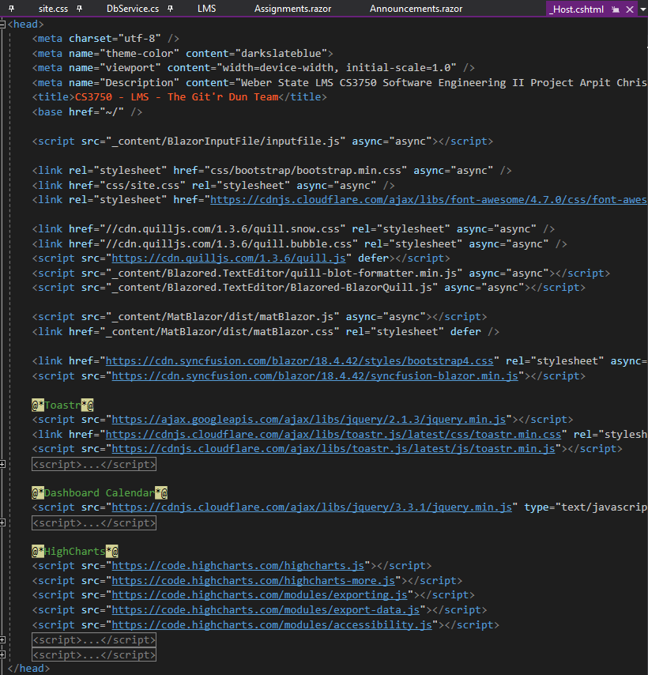
Client-Side Libraries
Blazored (General UI Components)
MatBlazor (Tables and Tooltips)
Toastr (Notifications)
Syncfusion Blazor (Calendar)
Blazor Input File (File Upload Helper)
HighCharts (Charts)
Blazored Local Storage (Session Storage)
Notes:
A few custom client-side libraries were used in the making of this project. Ones worth mentioning are above. Because such a rich UI is involved for LMS, it made sense to use the latest and greatest that we could find. Not only did doing so speed up the development process, but the libraries have been thoroughly tested. With the rich UI and the beauty of Blazor, a satisfying UX could be developed in a short time frame.

Slide 6
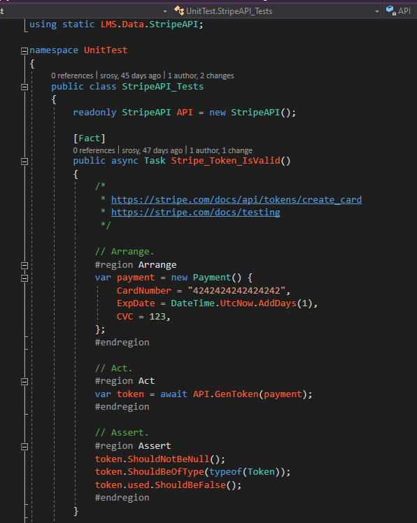
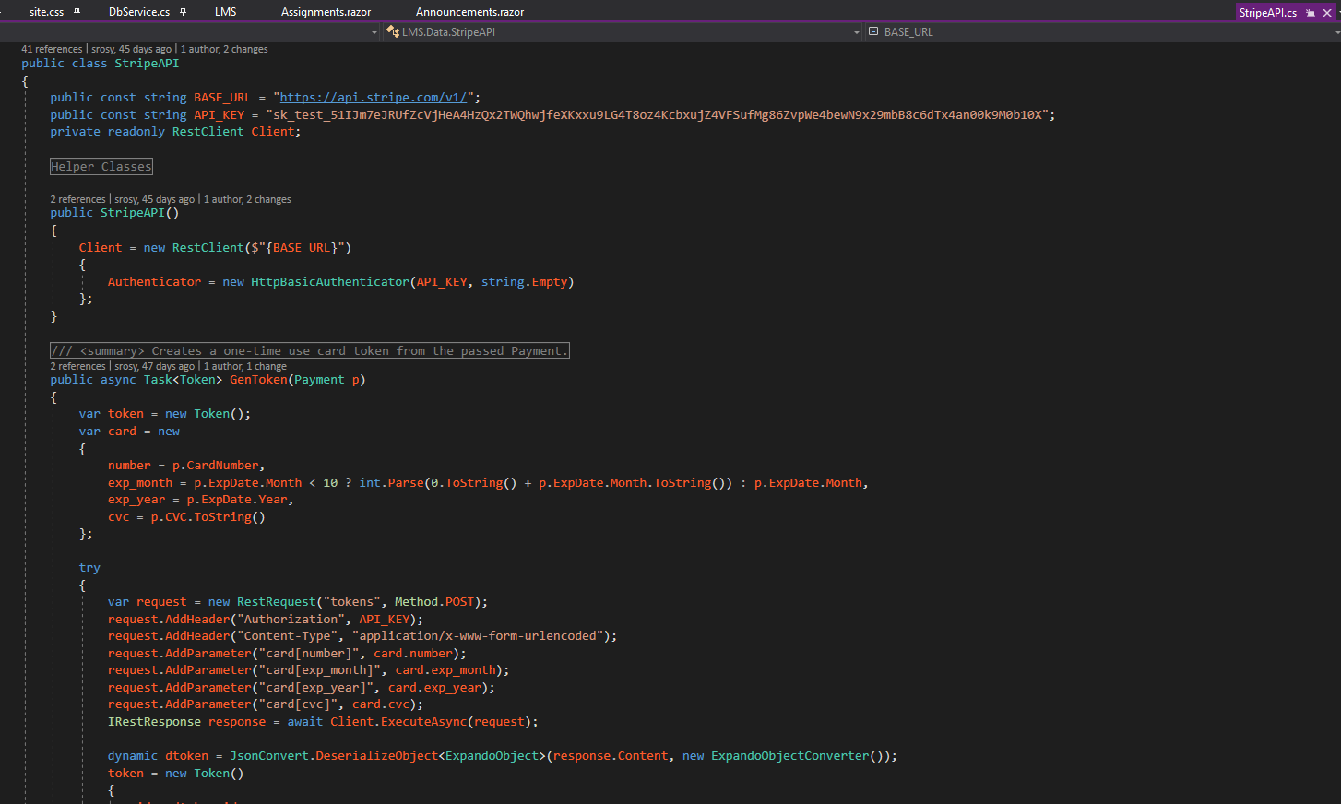
API Integration & Testing
StripAPI
RestSharp
Xunit
Shouldly
Arrange.
Act.
Assert.
Notes:
API’s and Testing were core components to our web app. One notable API integration is the StripeAPI to process credit card transactions. We utilized RestSharp and Netwtonsoft to make any restful calls, as it’s the current industry standard. For any testing we followed the Arrange Act Assert industry testing standard for standardized unit tests. Xunit is the most common C# Unit Testing Library and along side it is the most common Unit Test Helper Library, Shouldly. Shouldly allows a user to create unit tests in such a way that allows natural speaking. See the Assert region of the Stripe_Token_IsValid function.

Slide 7
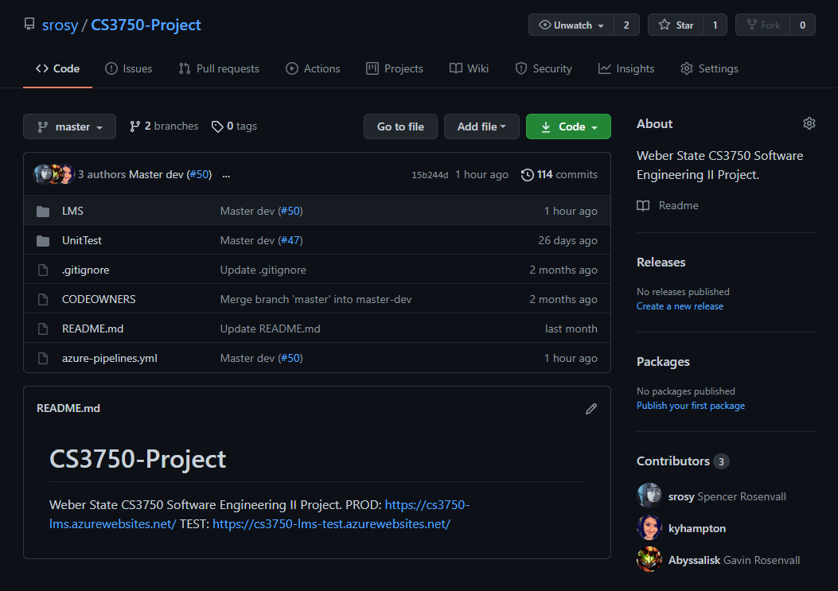
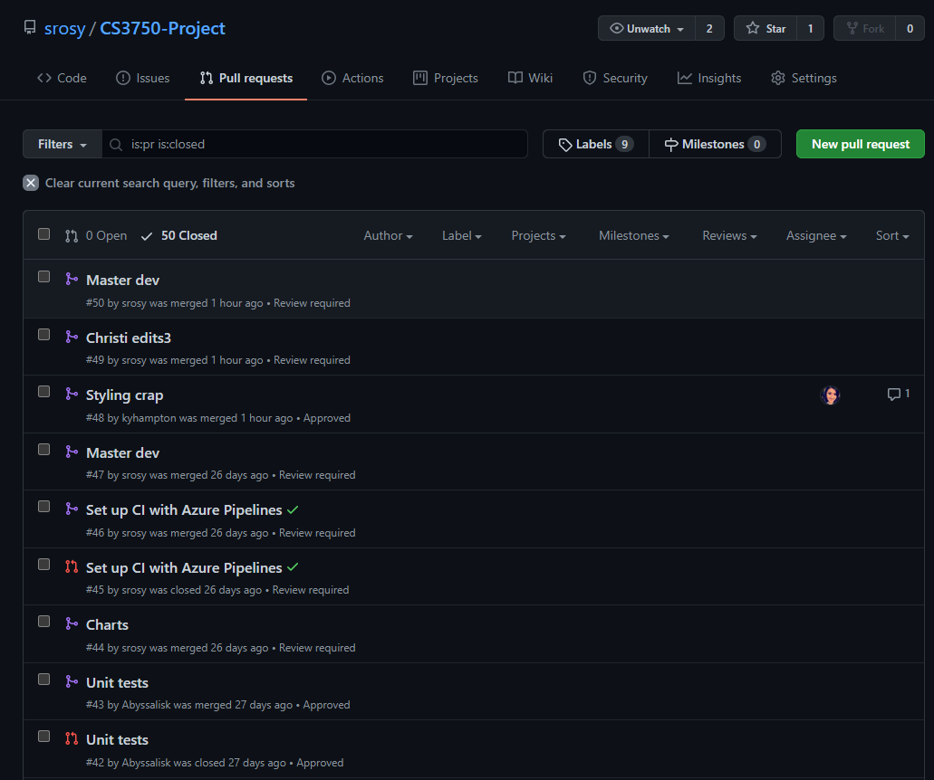
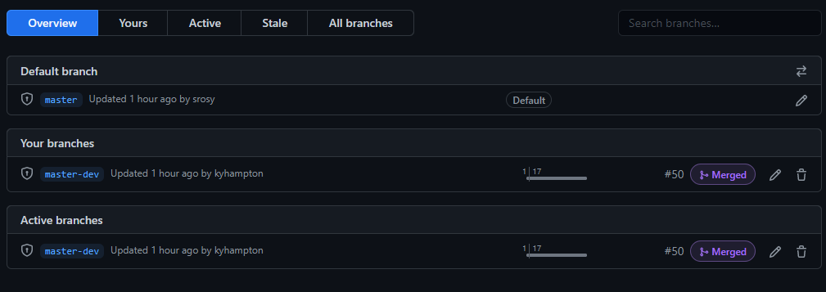
Versioning & Source Control (Git)
Master (prod)
Master-Dev (test)
Feature Branches
Pull Requests
Notes:
Versioning for us was a little more complicated. We used git to host our codechanges, but because we had a separate test and production environment, we had separate branches to reflect this, namely: Master for production, and Master-Dev for test. The source control flow was as follows: 1. A feature branch was made. 2. Code changes were commited and pushed to the feature branch. 3. A pull request was made for the feature branch with a required reviewer to review the changes and approve them. Should the changes not be approved, changes were requested and the pull-request was in holding until further updated for re-review. 4. When a pull request is approved, it is merged into the Master-dev branch. 5. When the master-dev branch is updated, the test site is updated to reflect those changes. 6. Additional testing is done on the test site. 7. At the end of a sprint or completion of a core feature, and after testing in the test environment, if everything appears correct, the Master branch is updated from the Master-Dev branch and the production site is updated with those changes. This was our source control flow.

Slide 8
https://3750-lms.azurewebsites.net/
Notes:
This concludes the Git’r Dun Team’s Learning Management System architecture overview.

